Slide 1
Creating a Bot to Play Ticket to Ride
Group members: Cameron Ake (cake)
Date: 10/23/2023
Period: 4
Milestone: October 23-31, 2023

Slide 2
Problem
I want to make a bot to play Ticket to Ride!
Strategy board game!
Generally, playing friends online isn’t feasible; playing in-person takes an hour, so playing a bot is usually the most feasible option to do
The bots are unhelpful for experimenting with strategies or having fun, because they always lose

Slide 3
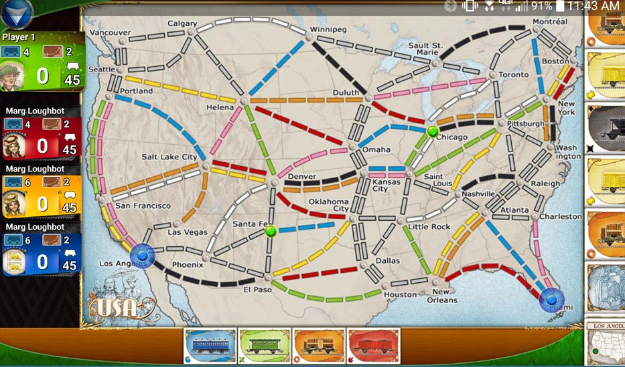
BACKGROUND
Ticket to Ride App
Game mechanics (basic overview)
Drawing cards
Tickets
Playing trains
Earning points
Game end
Image from https://oneboardfamily.com/app-review-ticket-ride/

Slide 4
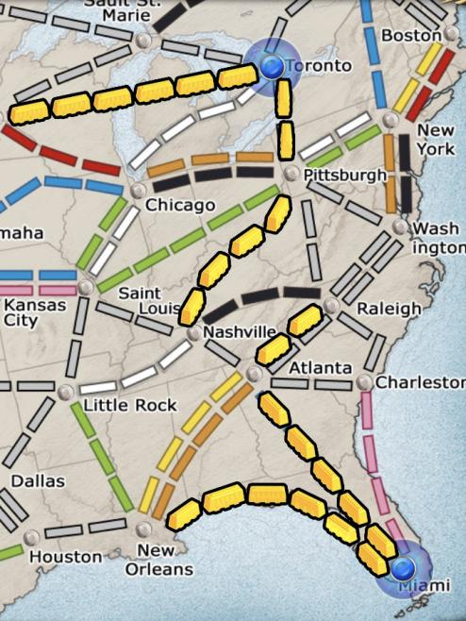
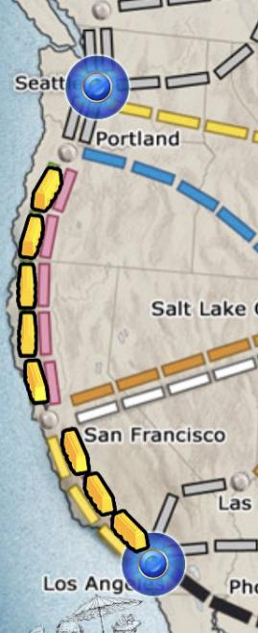
OTHER SOLUTIONS
Current Ticket to Ride bots
Don’t take necessary routes
Generally make transparently bad decisions, even late-game
Previous implementations:
Paper: “reinforcement learning for this is bad”
Java implementation posted on GitHub
Improper implementation of connections
Someone on Reddit coded some functionalities and basic strategies but not anything in terms of learning strategy

Slide 5
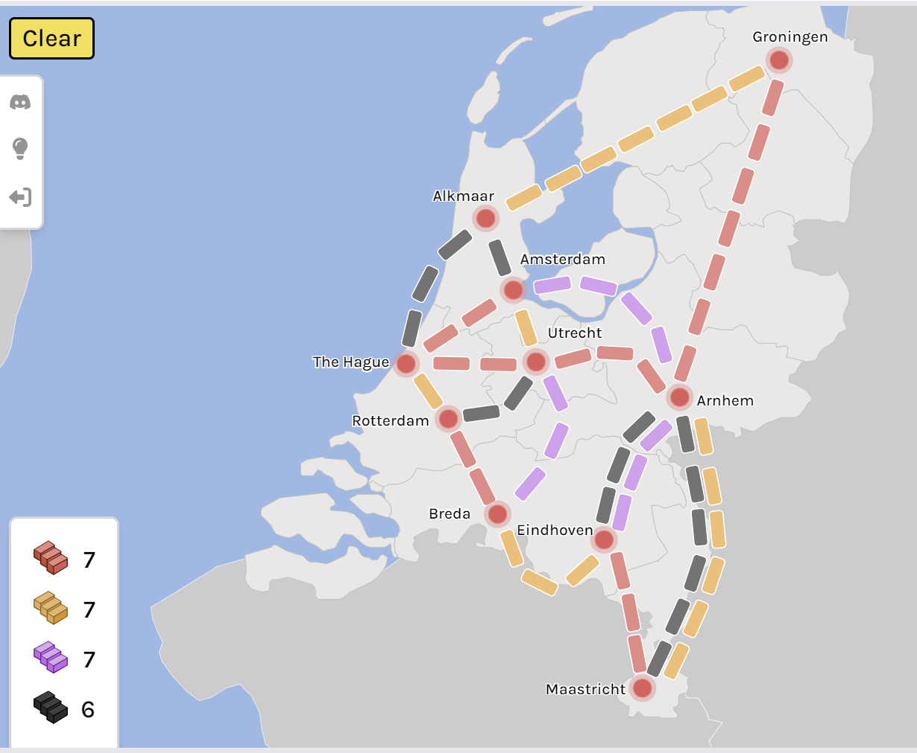
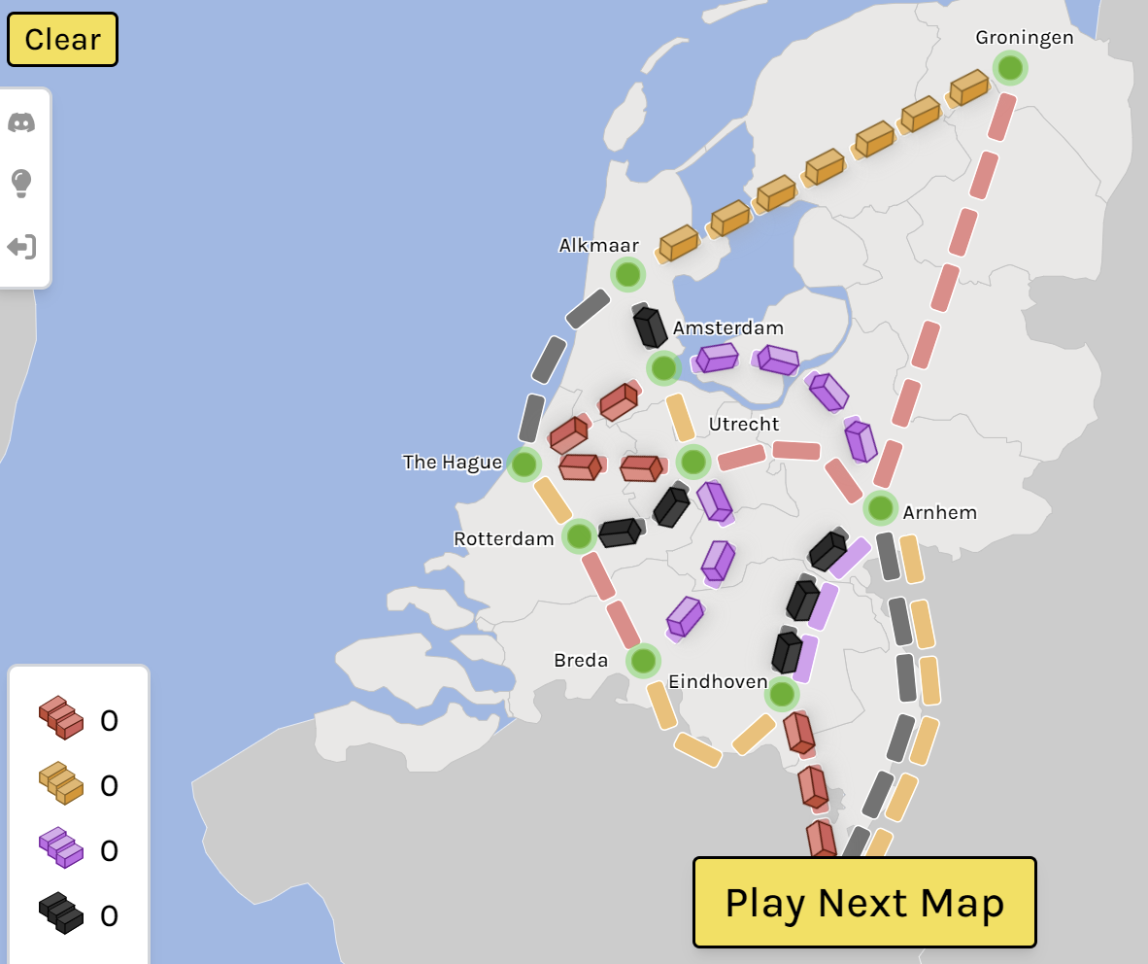
MORE OTHER SOLUTIONS
Reddit people who made an implementation of Ticket to Ride online
It (presumably) violated copyright and they changed it to a puzzle game
https://www.railbyrail.com/
More papers by the same people who had said it was implausible
Took a team of nine professors, who created very strong bots
We want bots who will also lose to humans every so often - perfection isn’t desirable

Slide 6
Why IS Ours BETTER?
Detailed earlier
Could use varying parameters to simulate different strategies and have many iterations of bots play against each other to actually “learn” good strategies (develop them on their own)
Haven’t hashed out exact algorithm yet; I’ve focused more on creating the functionality of the game so far
More tailorable to create bots at any particular desired skill level

Slide 7
Novelty
New implementation (nobody has made a bot as versatile as I plan to)
Better (hopefully) bot!
More often that the bot wins compared to the lackluster current bots, but not so often that it will discourage humans

Slide 8
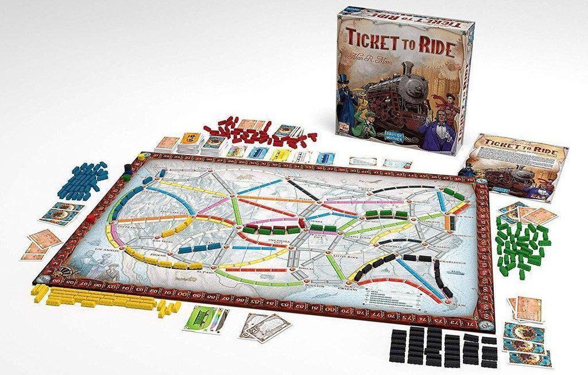
ImPACT
More ability for Ticket to Ride players to develop their abilities and enjoy the game by playing challenging bots
More development in terms of the possibilities of artificial intelligence for complex games
Copyright problematic for simply creating a website:
Possibility of creating spinoff
Alternative possibility of selling AI algorithms to Days of Wonder to implement

Slide 9
METHOD
I have (almost completely) finished making a bot that acts randomly, and tests game possibilities
Method to take turns, method to play through game, graph traversal to find which tickets have been found
After RandomBot is polished up, I’ll add in heuristic functions for the amount that a given bot “wants” to make a given move on their turn by using their values for how much they “like” given things so the bot can make a next move
Then, create algorithm to pit bots against each other and choose the best parameters for decision-making
Potentially, genetic algorithm-esque: generate new bots based on the bots that worked well each time the bots are pitted against each other
Maybe: selecting bots with clearly different “strategies” for some variety
Then, make spinoff TTR website to implement if I have time? Or see if I can work with Days of Wonder about this given results (very unsure how long the middle part will take)

Slide 10
METHOD: Systems Architecture
Input:
Initial state of board
Cards
Tickets
Strategy parameters for each bot
During:
Graph for routes
Dictionary for cards in hand
Graph search (smallest route)
Strategy parameters
repeat!
Output:
Moves (state of board each turn)
Winner and points
In-between:
Which bots did best?
Adjust parameters for bots
New match between bots

Slide 11
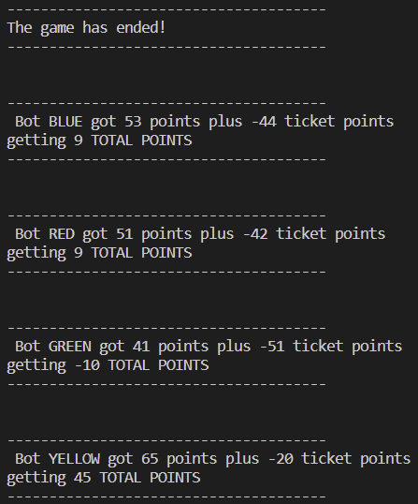
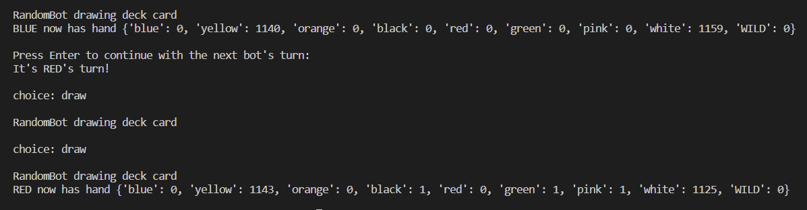
RESULTS
Data structures done!
RandomBot is done! I fixed at least 15 bugs, but I made it take every type of action, have had it play full games, and have added a mechanism to see if a ticket is satisfied
Close to done w/implementing overall game!

Slide 12
Limitations
As mentioned prior, difficulty of implementing reinforcement learning
Difficulty of making website; new territory if I get to that point
Alternative: Reach out to Days of Wonder
Possibility that they will ghost and/or not care

Slide 13
CONCLUSION AND FUTURE WORK
Going well so far! (although lots of bugs I’ve had to deal with)
Next steps:
More research on potential algorithms to use
Functionality to have player play against bot
Test with RandomBot

Slide 14
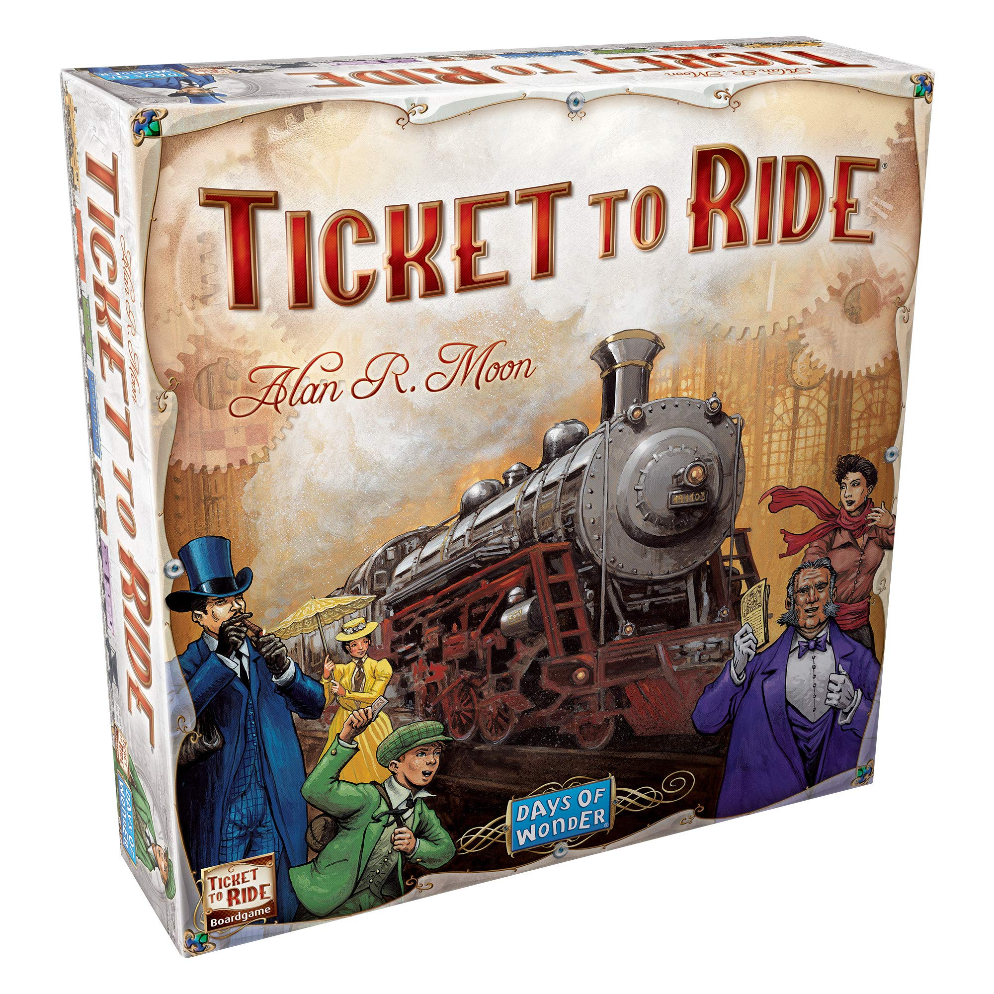
Q&A
Thanks!
Questions?

Slide 15
REFERENCES
Ticket to Ride app from Days of Wonder on App Store
Stack Overflow for Python tips (most notably, sorting out data structures and classes in different files)
Destination ticket data from Fandom
Reinforcement Learning Is Bad For TTR paper (Daniel Dinjian & Cuong Nguyen, from Tufts University)
Reddit Person Who Made More Basic Bot
Github With Bad Information
railbyrail.com
Professors who Used Reinforcement Learning

Slide 16
THANKS!

